Slide 1
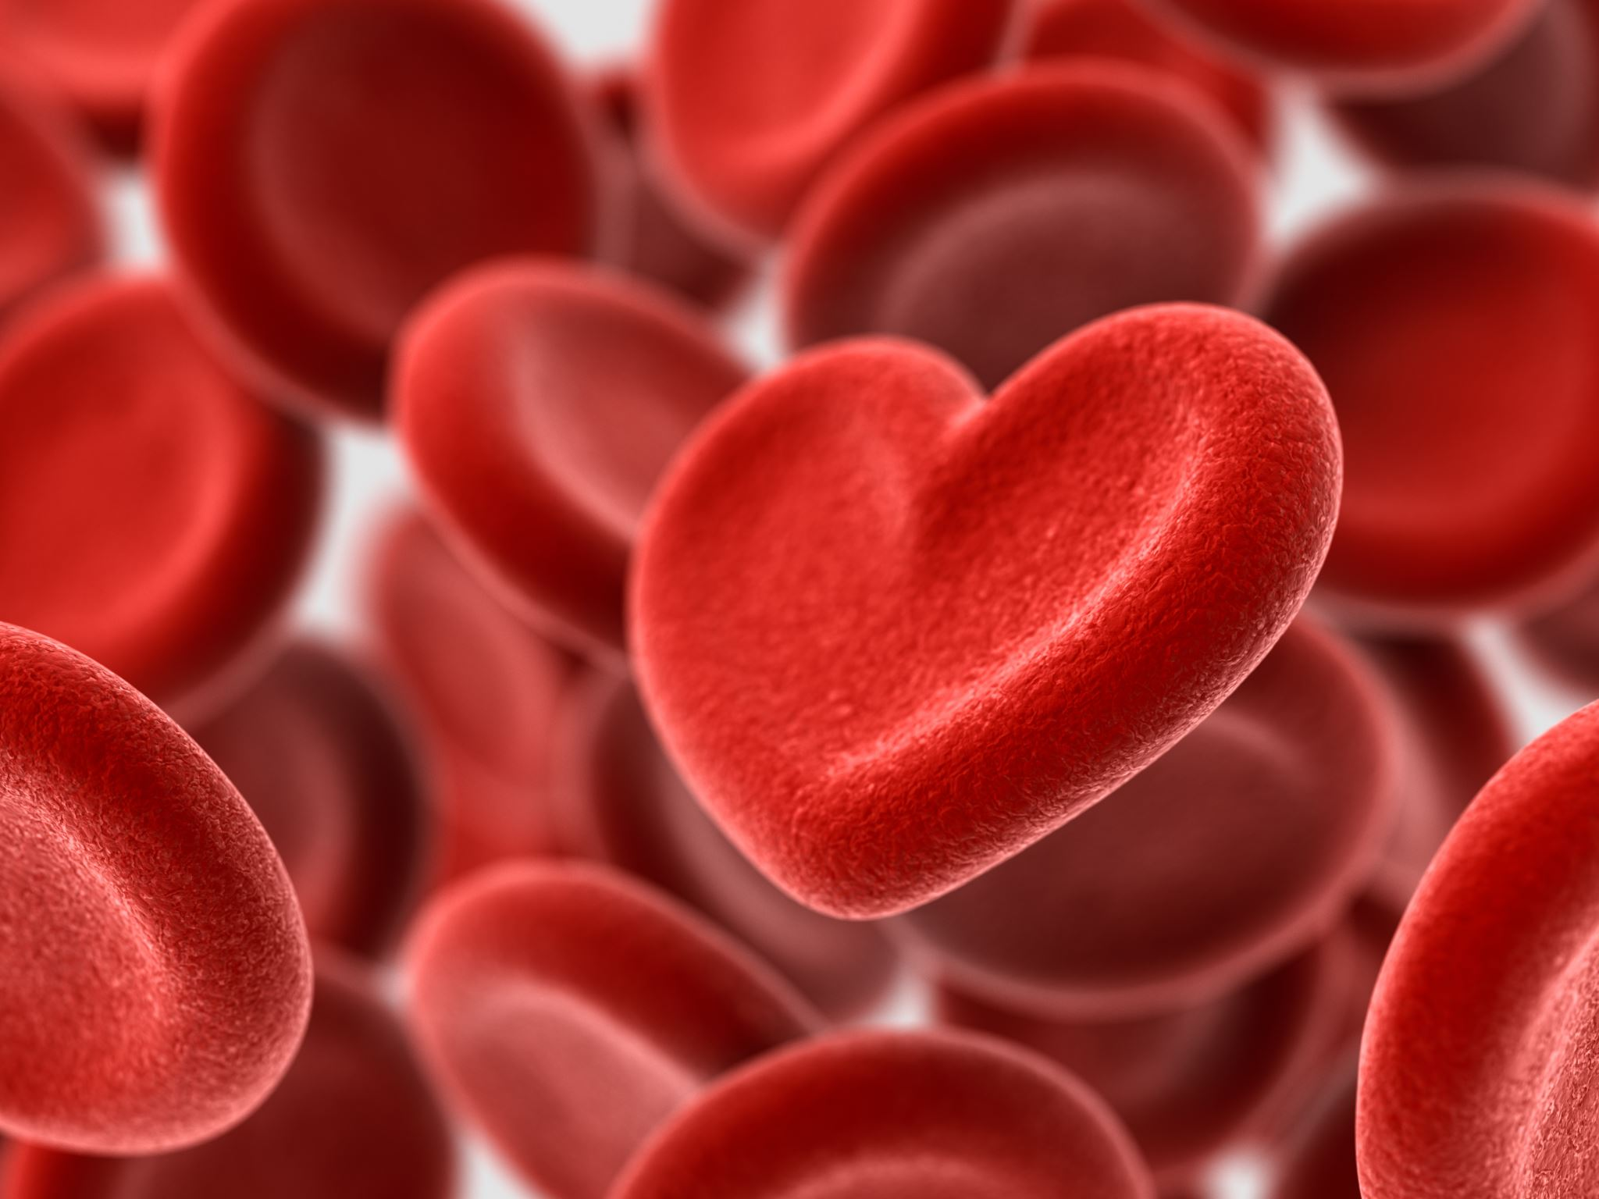
Week 6

Slide 2
Blood Basics
Hematopoiesis
Erythropoiesis
RBC Labs

Slide 3
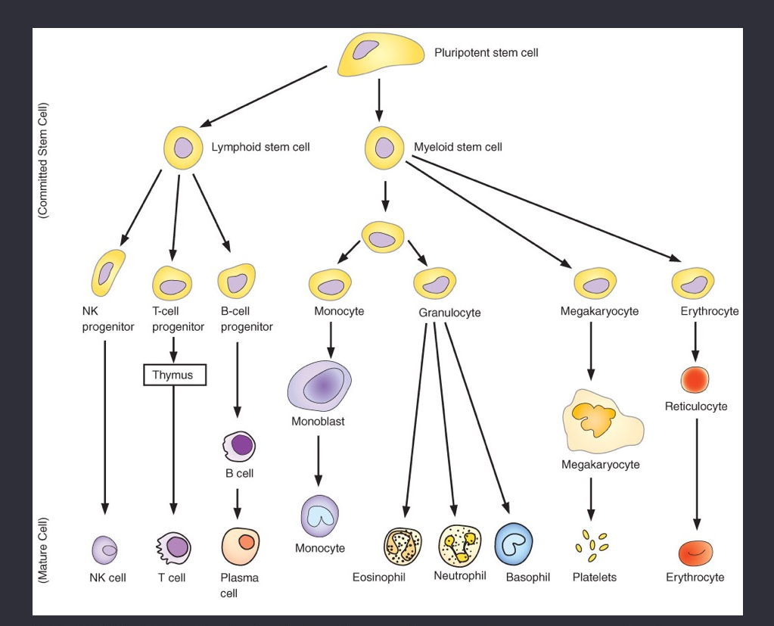
Bone Marrow
Myeloblast
CD4 & CD8
Lymph nodes
Lymphocytes

Slide 4
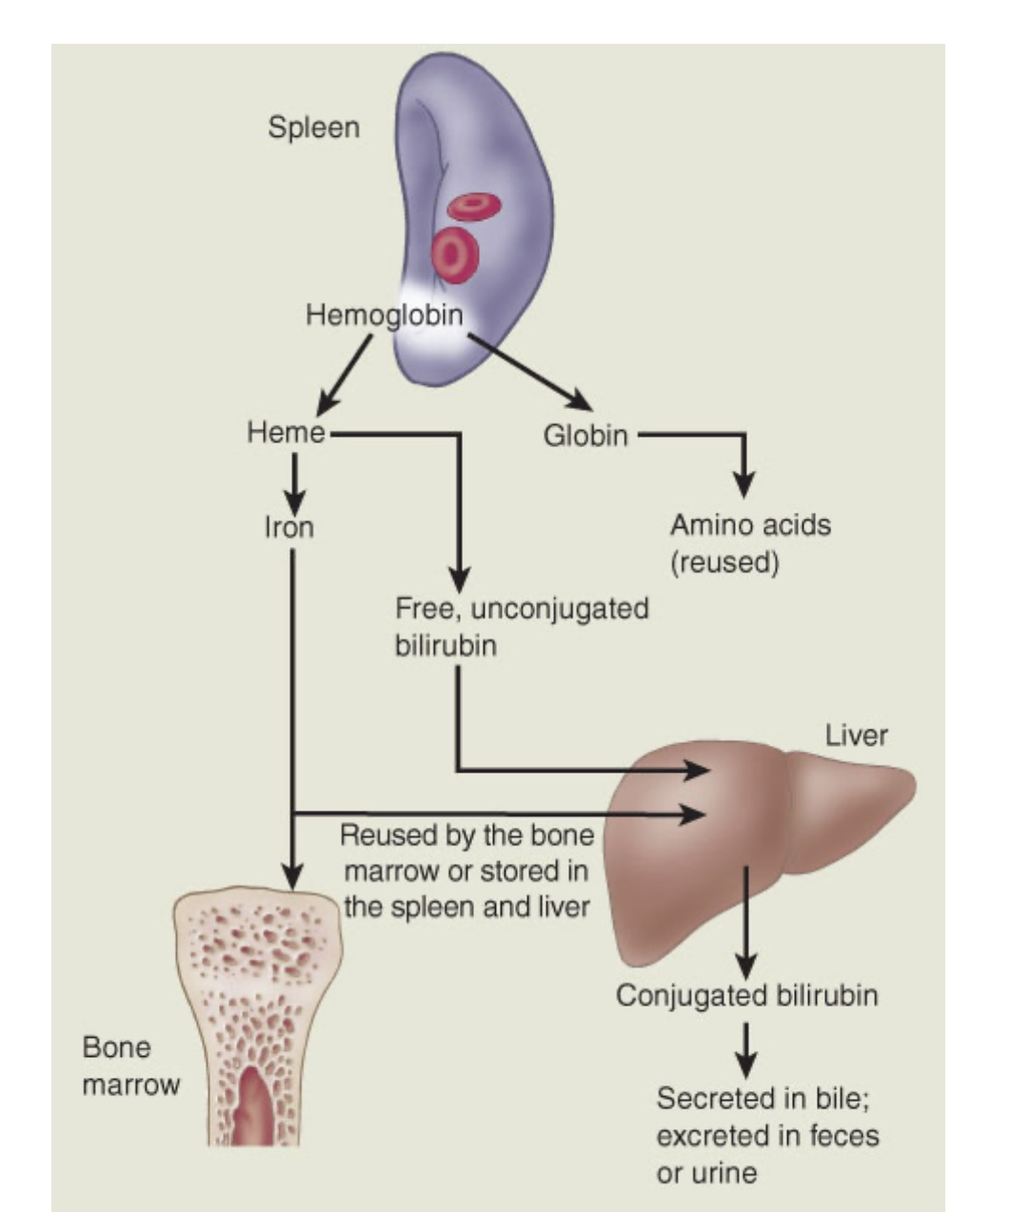
How Hemolysis Works

Slide 5
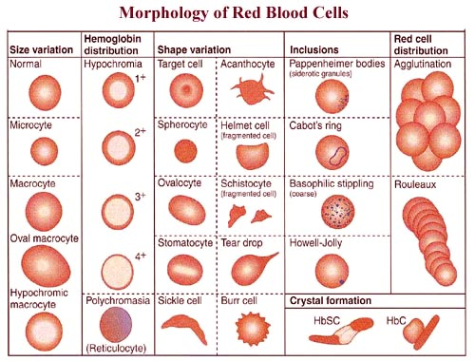

Slide 6
Which of the following statements is true regarding hematopoiesis and erythropoiesis? Select all that apply.
Hematopoiesis is the process by which only new RBCs are made.
Erythropoiesis is stimulated by the kidneys in response to hypoxia.
Erythropoietin is secreted by the bone marrow.
Hematopoiesis involves formation of RBCs, platelets, and WBCs.
Notes:
B, D

Slide 7
What is unconjugated bilirubin?
Bilirubin that makes up bile
Bilirubin that the liver helps excrete in stool
Bilirubin that remains in the vessels and causes jaundice
Immature RBCs
Notes:
C

Slide 8
What does MCV tell you?
Color of RBC
Hemoglobin concentration in the blood
Size of RBC
Viscosity of the blood
Notes:
C

Slide 9
Hemostasis (Clotting)
Process of Hemostasis
Disorders of Hypercoagulability
  DVT, Thrombocytosis
Disorders of Hypocoagulability
  Thrombocytopenia, Von Willebrand, Hemophilia

Slide 10
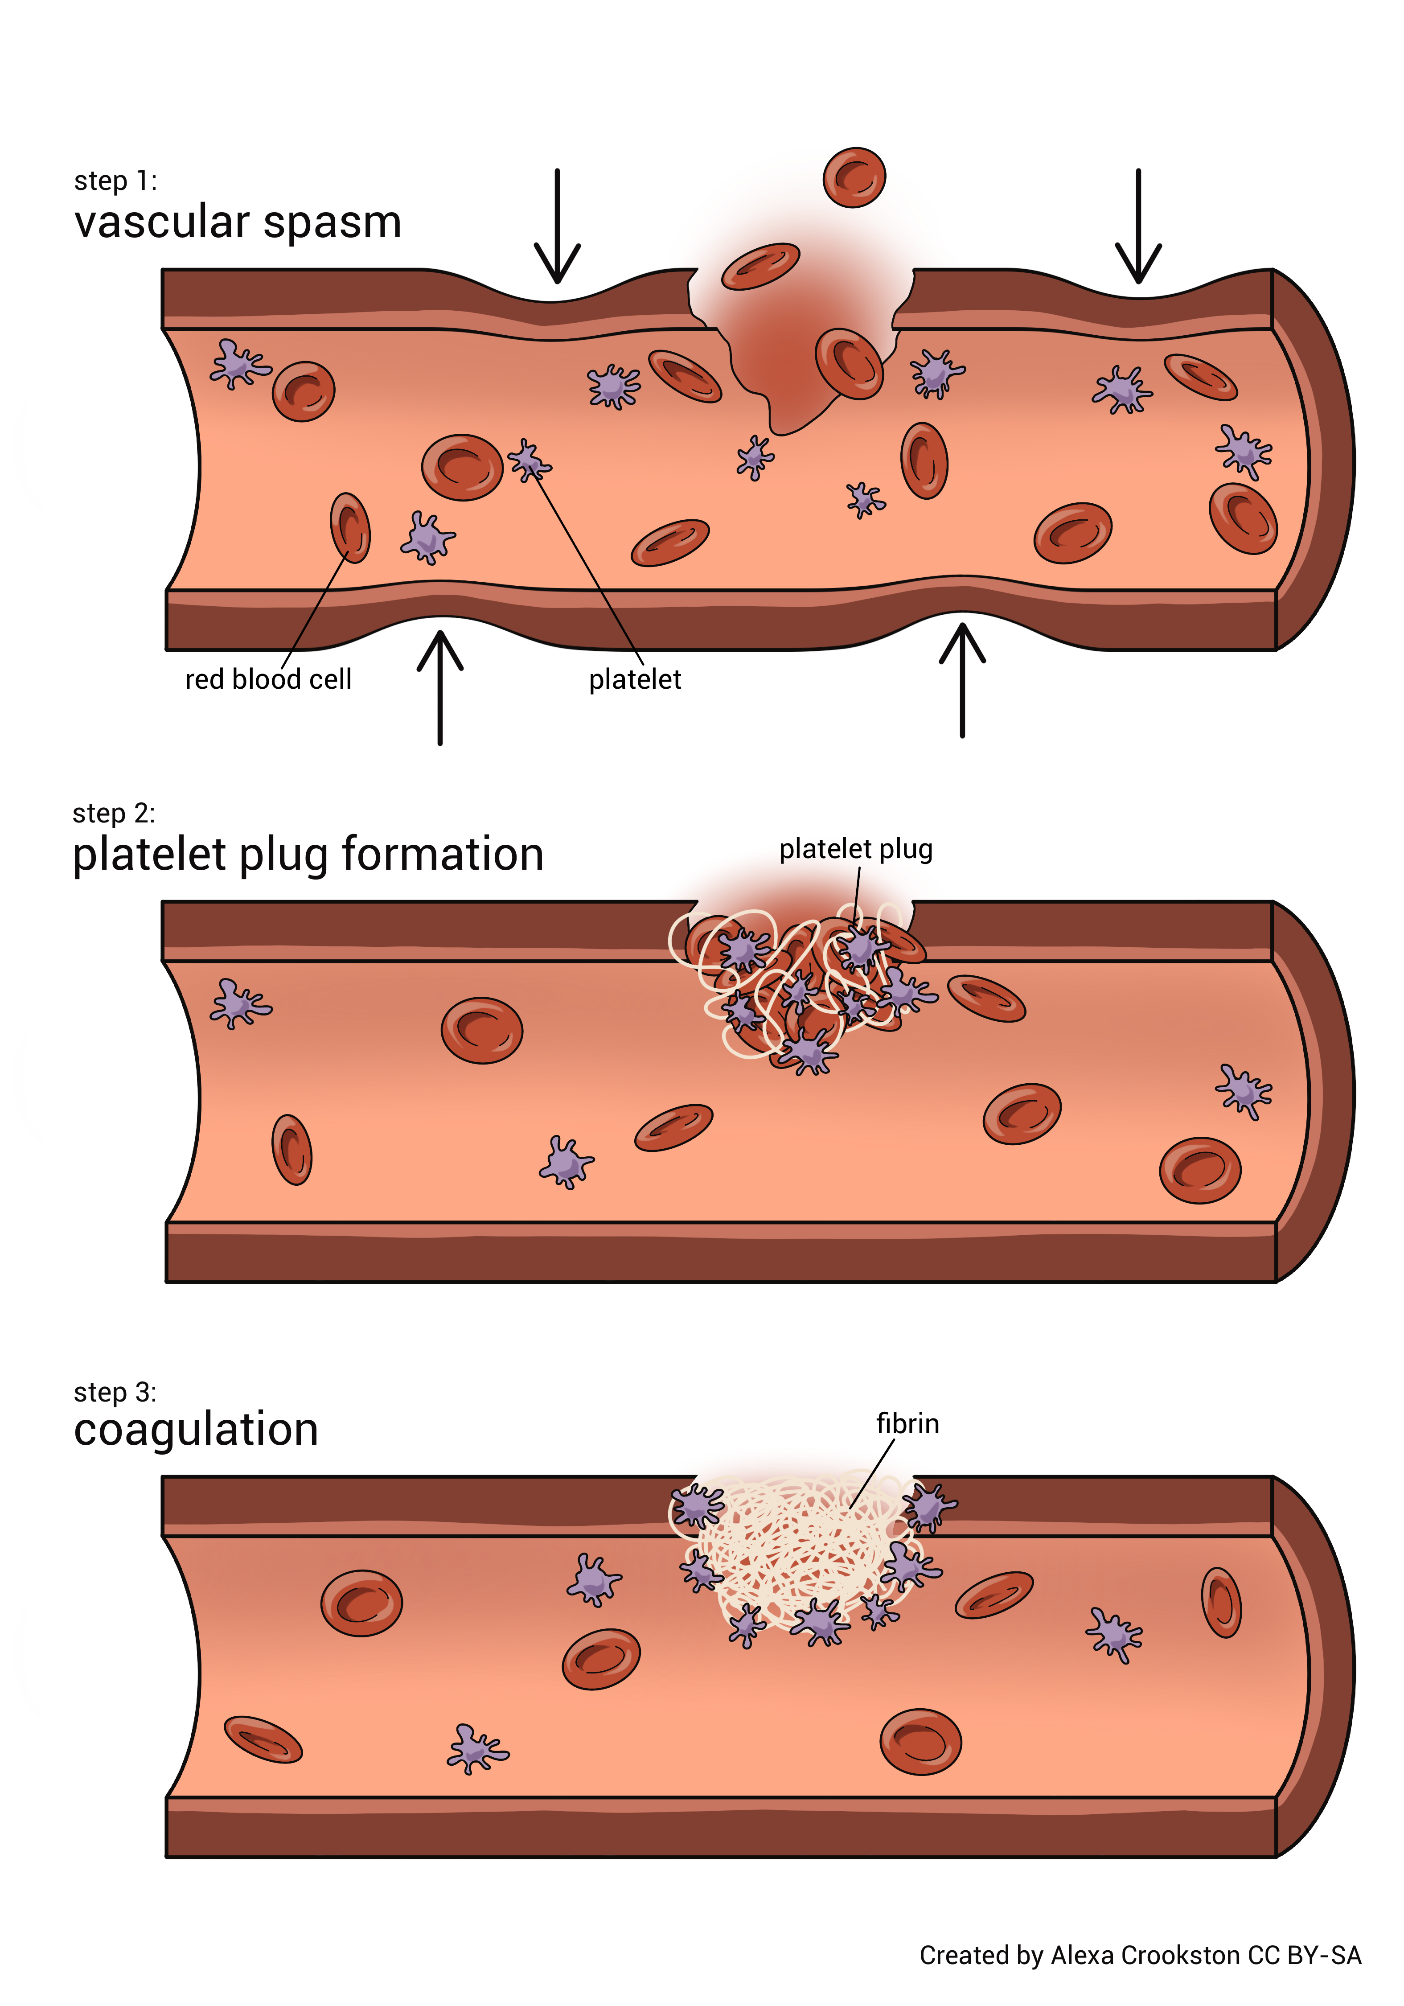
Hemostasis

Slide 11
Put the steps of hemostasis and clot dissolution in the correct order.
Platelet plug
Coagulation
Fibrinolysis
Clot retraction
Vasoconstriction
Notes:
E, A, B, D, C

Slide 12
How do small vessel breaks heal?
Platelet plug
Fibrinolysis
Coagulation cascade
Clot retraction
Notes:
A

Slide 13
Determine which coagulation proteins are found in hemostasis and fibrinolysis.
Coagulation Proteins | Hemostasis | Fibrinolysis
Fibrin
Plasminogen
Prothrombin activator
Thrombin
Plasmin
Notes:
Fibrin – hemostasis
Plasminogen – fibrinolysis
Prothrombin activator – hemostasis
Thrombin – hemostasis
Plasmin – fibrinolysis

Slide 14
Which part of hemostasis involves the fibrin meshwork?
Platelet plug
Fibrinolysis
Coagulation
Clot retraction
Notes:
D

Slide 15
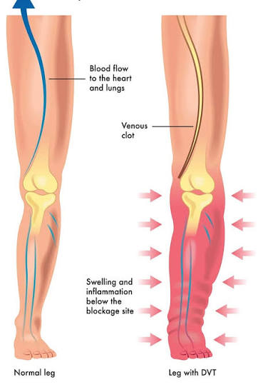
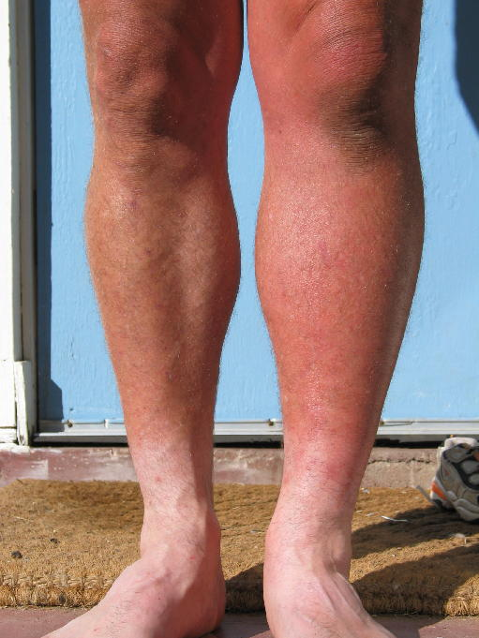
DVT

Slide 16
Anemia
Hemolytic Anemias
  Sickle Cell, Thalassemia
Nutrient Problems
  Iron Deficiency, Megaloblastic/Pernicious
Aplastic Anemia

Slide 18
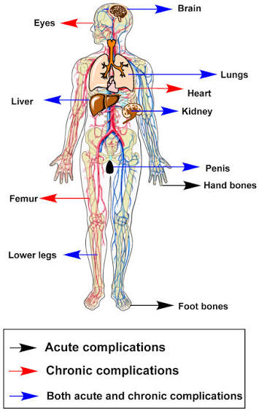
Sickle Cell Anemia
GROUP ACTIVITY! ☺

Slide 19
What are the manifestations of general anemia?
Erythema, tachypnea, hypertension, dyspnea
Petechiae, dyspnea, pain, ecchymosis
Pallor, fatigue, dyspnea, tachycardia
Cyanosis, dyspnea, confusion, chest pain
Notes:
C

Slide 20
A patient presents with severe pain over multiple areas of the body, pallor, weakness, dyspnea, tachycardia, jaundice, and splenomegaly. Which anemia does the nurse suspect?
Iron deficiency anemia
Pernicious anemia
Aplastic anemia
Sickle cell anemia
Notes:
D

Slide 21
Which patients are most at risk for iron deficiency anemia? Select all that apply.
A patient with heavy menstruation
A patient with chronic stomach ulcers
A patient on radiation and chemotherapy
A patient with a diet low in iron
A patient with an abnormal inherited gene
Notes:
A, B, D

Slide 22
A nurse is educating a patient about their new diagnosis of pernicious anemia. Which of the following statements by the patient is incorrect?
“My recent gastric surgery and chronic gastritis caused this.”
“My symptoms may include numbness and tingling, nausea, diarrhea, and a red swollen tongue.”
“The lack of intrinsic factor causes a large immature RBC.”
“My poor dietary habit is what caused this.”
Notes:
D

Slide 23
What is a potential complication of sickle cell anemia?
Vaso-occlusive crisis
Bone marrow failure
Dehydration
Impaired digestion
Notes:
D

Slide 24
Which type of anemia is macrocytic and normochromic?
Iron deficiency
Thalassemia
Sickle cell
Pernicious
Notes:
D

Slide 25
Determine if there is high or low MCV and MCHC in each of the following anemias.
Anemia Type | High MCV | Low MCV | High MCHC | Low MCHC
Iron Deficiency
Pernicious
Aplastic
Sickle Cell
Thalassemia
Notes:
Iron – low MCV, low MCHC
Pernicioius – high MCV
Aplastic –
Sickle cell – high MCHC
Thalassemia – low MCV, low MCHC

Slide 26
What is the pathophysiological process of how anemia causes jaundice?
The liver has decreased perfusion and cannot conjugate bilirubin
There is increased breakdown of RBCs in iron deficiency anemia, which causes increased bilirubin in the blood
Hemolytic anemia results in unconjugated bilirubin
The spleen is infiltrated with sickled cells
Notes:
C

Slide 27
Which of the following statements is true of hemolytic anemias?
Aplastic anemia is a form of hemolytic anemia.
Sickle cell and thalassemia are both genetic disorders.
Hemolytic anemias do not cause iron overload and subsequent hepatomegaly.
Hemolytic anemias are caused by massive hemorrhage.
Notes:
B

Slide 28
Nursing Blood Things
Blood Typing
Transfusions
  Transfusion Reactions

Slide 29
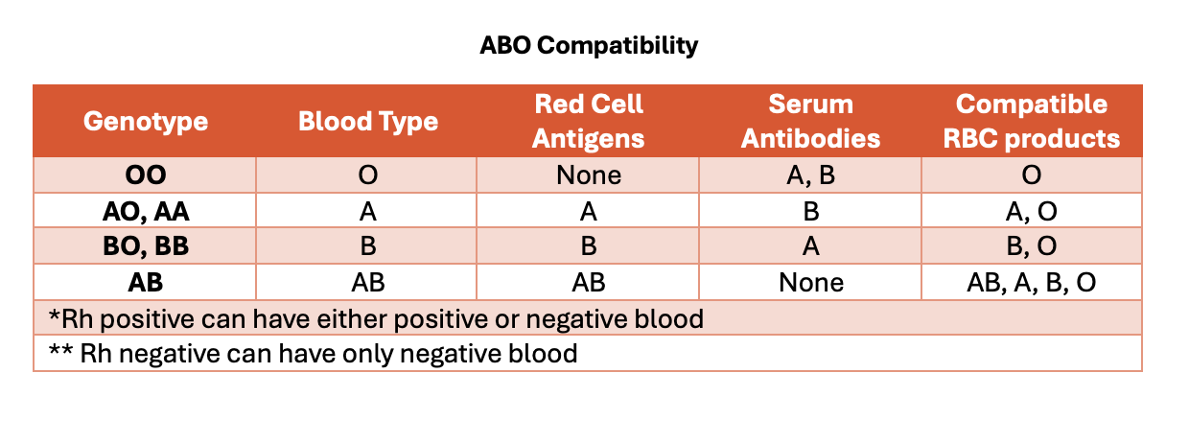

Slide 30
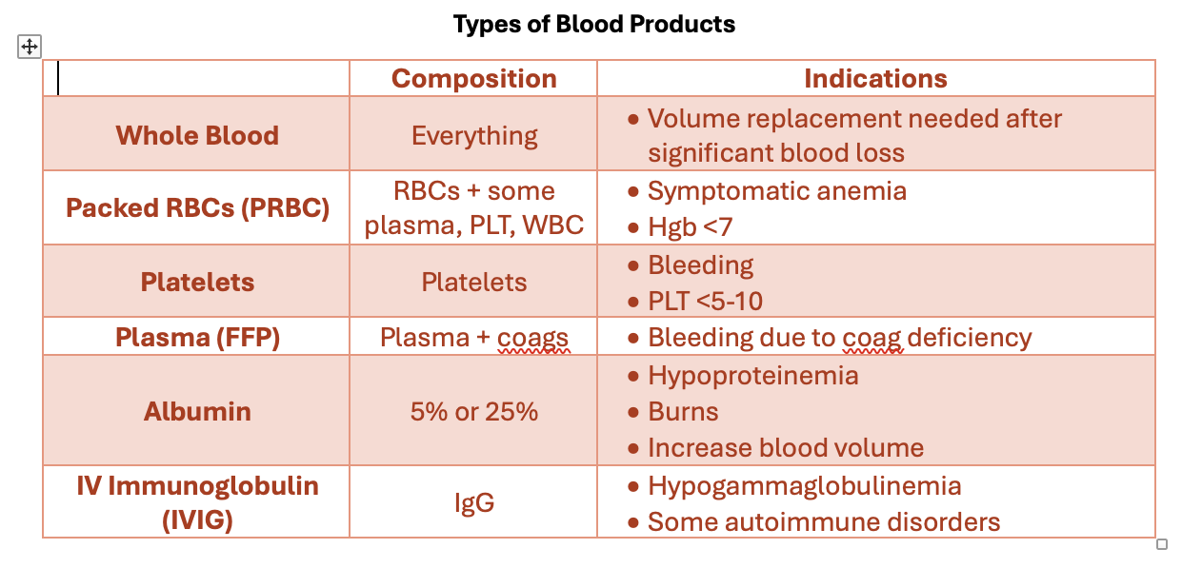

Slide 31
Which blood products can a patient with AB negative (AB-) blood receive? Select all that apply.
O+
O-
A+
B-
AB+
AB-
Notes:
B, D, F

Slide 32
Which blood products can a patient with
O positive (O+) blood receive? Select all that apply.
O+
O-
A+
B-
AB+
AB-
Notes:
A, B

Slide 33
Which of the following are potential blood transfusion reactions? Select all that apply.
Allergic reaction
Hemolytic reaction
Febrile reaction
TACO
TRALI
Notes:
All

Slide 34
WBC Disorders
Leukopenia
Mononucleosis
Proliferative Disorders
  Lymphomas
  Leukemias

Slide 35
Bone Marrow
Myeloblast
CD4 & CD8
Lymph nodes
Lymphocytes

Slide 36
Bone Marrow
Myeloblast
NHL & HL
CD4 & CD8
Lymph nodes
Lymphocytes

Slide 37
Which of the following lymphocytes can be affected by lymphoma? Select all that apply.
B cells
T cells
NK cells
Macrophages
Neutrophils
Notes:
A, B, C

Slide 38
Select whether the following manifestations are associated with Non-Hodgkin or Hodgkin lymphoma.
Manifestation | NHL | HL
Starts in lymph nodes
Burkitt lymphoma
Reed-Sternberg cells
Poor humoral response
Pruritus
Notes:
Starts in LN – HL
Burkitt – NHL
Reed-Sternberg – HL
Poor humoral response – NHL
Pruritus - HL

Slide 39
AML
Bone Marrow
ALL
Myeloblast
CD4 & CD8
Lymph nodes
Lymphocytes

Slide 40
CML
Bone Marrow
CLL
Myeloblast
CD4 & CD8
Lymph nodes
Lymphocytes

Slide 41
Which type of leukemia is most common in children?
AML
ALL
CML
CLL
Notes:
B

Slide 42
Which types of leukemia are most associated with leukostasis? Select all that apply.
AML
ALL
CML
CLL
Notes:
A, B, C
ML more than LL

Slide 43
Which type of leukemia is a disorder of the pluripotent stem cells?
AML
ALL
CML
CLL
Notes:
C

Slide 44
Which types of leukemia suppress proliferation of all other types of blood cells? Select all that apply.
AML
ALL
CML
CLL
Notes:
All

